Slide 1

Researching the Researchers:
Using their work to secure the next generation of Aerospace Technology
Hack Space Con 2023

Slide 2



About Lost0x01
Threat Intelligence Analyst
Malware Analyst
Former DFIR
GREM and other fancy letters
Former Mechanic and Chef
Bourbon and Sailing
Learning to Tattoo

Slide 3


Agenda
Who are the researchers?
What are they looking at?
How do we turn this into actionable intelligence for product security?

Slide 4
What we look for
Quality of Research
Relevant Research
Influence and Reach

Slide 5


Finding all the things
A quick look into some of what is being researched in the industry.
All research is used with permission
First up: IFE/IFEC

Slide 6
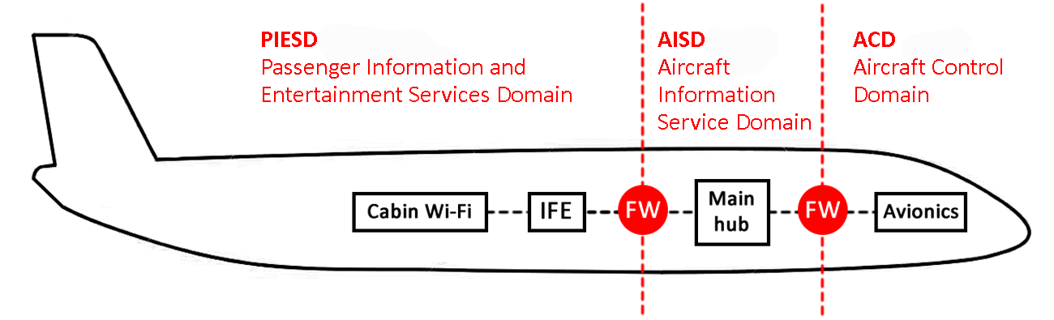
In Flight Entertainment (IFE/IFEC)
Using IFE/IFEC to create a distraction during flight
Lack of connectivity to other systems
Moving Map is no longer connected to any flight control systems.

Slide 7
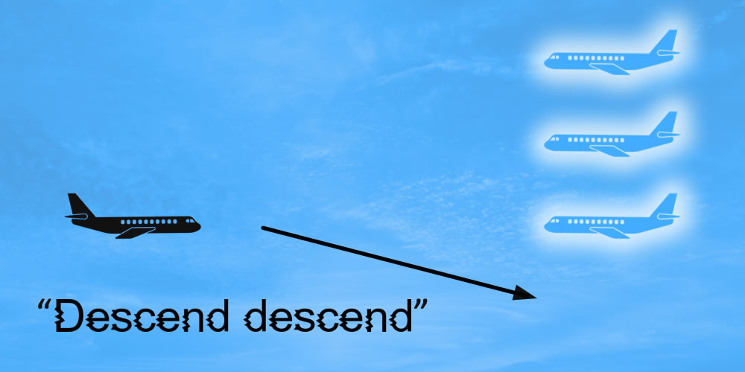


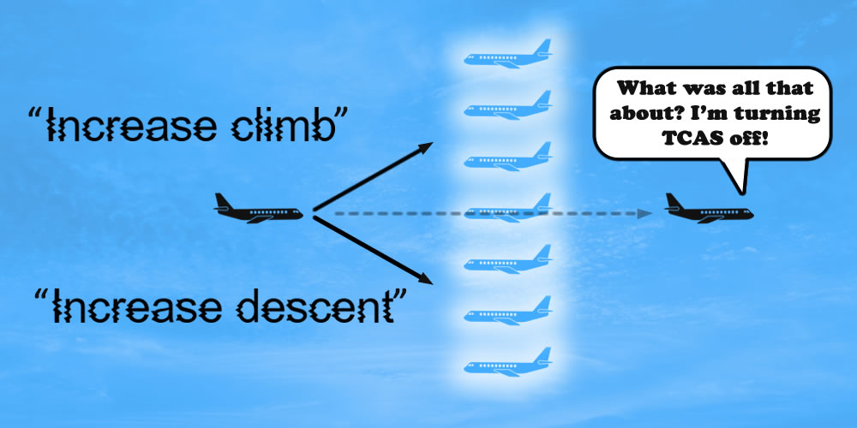
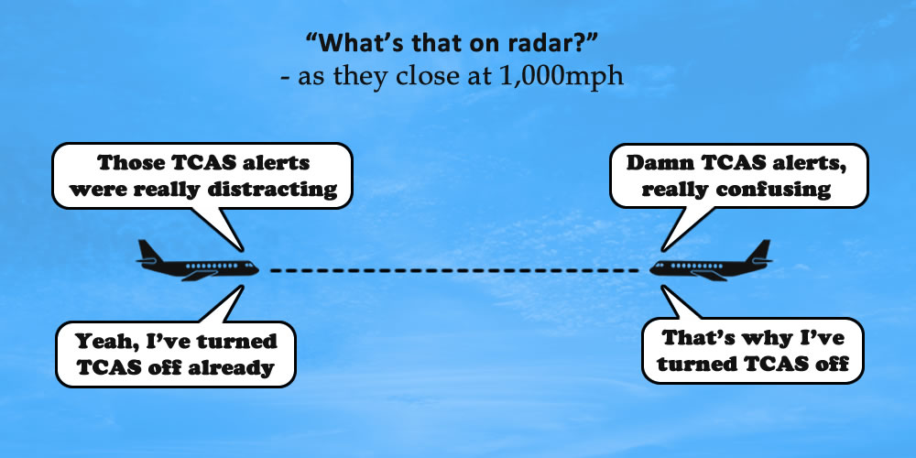
Traffic Alert & Collision Avoidance System (TCAS) Spoofing
Traffic Alert – audibly alerts pilot to the traffic.
Resolution Advisory – Give avoidance instructions.
RF transmissions in 2 possible modes
Mode S – Aircraft ID, Altitude, and GPS Heading
Mode C – Aircraft ID and Altitude
Prioritize dealing with closest threat first.
The data structure is easy to decode and a cheap, $10, DVB USB dongle can pick them up for you to plot aircraft data yourself

Slide 8
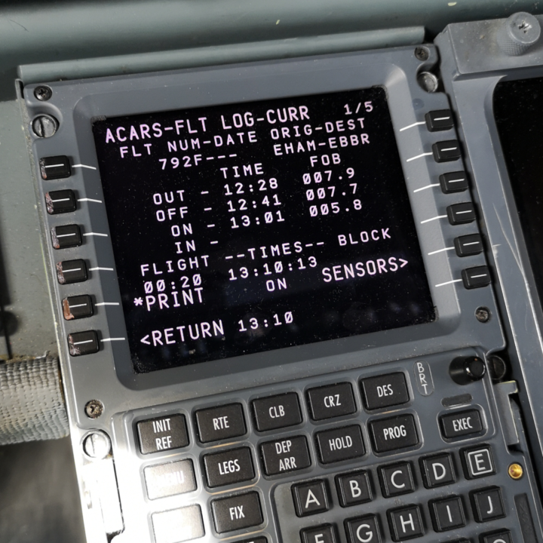
Aircraft Communications Addressing and Reporting System (ACARS)
Text based messaging system for aircraft pilots and Air Traffic Control (ATC)
VHF radio with a network of transmitters using Line of Sight Radios
Plain Old ACARS (POA) – uses a signal with each bit encrypted as a half bit sine wave.
ACARS over Aviation VHF Link Control (AOA) – uses phase shift keying modulation.
Future Air Nav Systems (FANS) – Consists of 2 parts and works like a text message service.
Controller Pilot Data link Communications (CPDLC) – Used to send pilot instructions from ATC
ADS-Contract (ADS-C) – ADS-B with more granularity can show current and future waypoints.
Parts of an ACARS Message
Header – Two-character label field indicating type of data being received.
Message – ASCII Alpha Numeric limited to 220 characters
Checksum – To help maintain message integrity

Slide 9
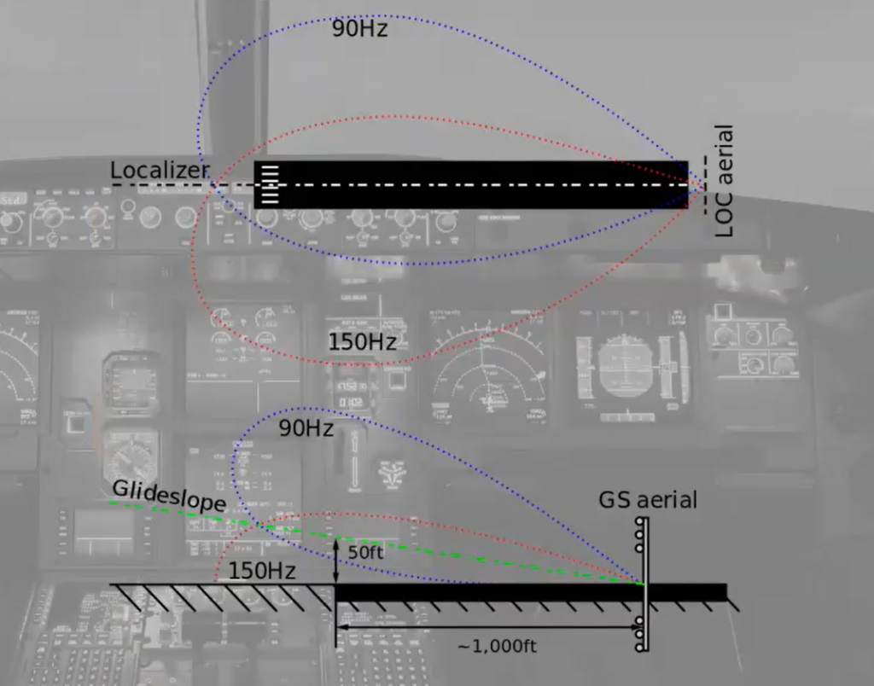
Instrument Landing System (ILS) Spoofing
ILS provides Lateral and Vertical guidance to pilots with relationship to the runway.
VHF Transmission with frequency given based off of requested runway.
Could be spoofed with a High-Powered Antenna positioned in close proximity to the airport.
Unlikely to be realistic due to the needed equipment and the likelihood of early discovery by Law Enforcement.

Slide 10
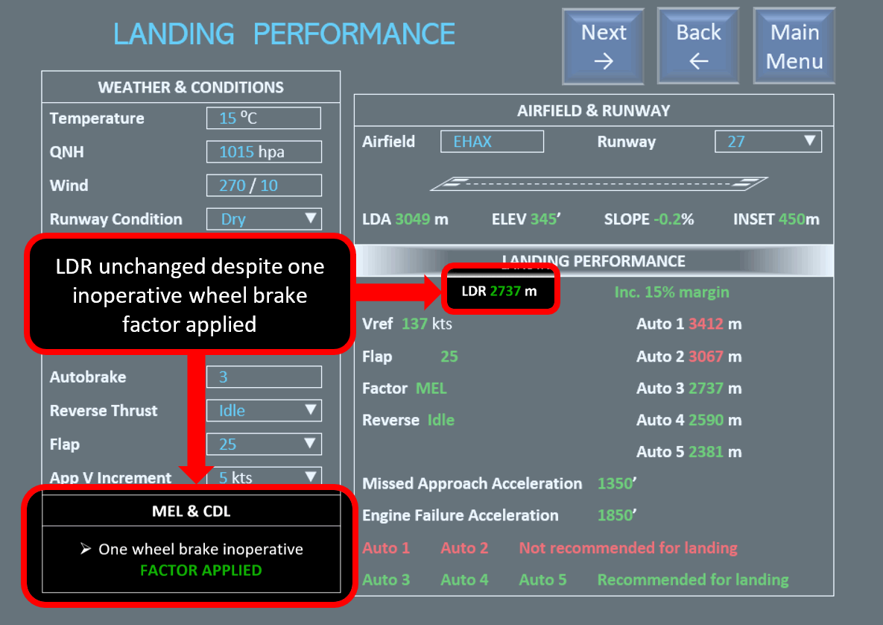
Electronic Flight Bags (EFB) Tampering: Approach and Landing performance
EFB’s are used to create Approach and Landing Calculations
Modifying any of this data could have severe consequences.
Possible consequences include overshooting the runway, not having proper speed on takeoff or landing, incorrect flap settings, and many more.

Slide 11

What we do with the Data from the Researchers
Research is analyzed by our CTI team and then sent to Product Security for further evaluation.
They work with engineers to find solutions to problems.
That was the easy part, or so we thought.

Slide 12

The Problem with fixes and Disclosure
Normal disclosure time frames do not work. (This does not mean don’t disclose)
Any changes with a system on an aircraft must go through multiple levels of inspection both internally and through the FAA. This takes time.
Replacing Old Infrastructure is being addressed but a lot of wanted changes can’t be made until this is done.

Slide 13


Special Thanks and Credit where credit is due
Thank you to Pentest Partners for allowing me to use their research as an example. More information and research can be found at their site: https://www.pentestpartners.com/

Slide 14


Thank You!
rob@lost0x01.com
Twitter: Lost0x01
Github: Lost0x01
Mastadon: Lost0x01@infosec.exchange

